Slide 1


Container Dashboard
Jasper van Woudenberg - DATDRD05-T08
Notes:
Thank you all for listening to my presentation of my individual project. This project has been done while attending the minor Data Driven Decision making in Business. I first of all want to thank the tutors for their guidance during the minor.
The real world issue i wanted to adress in my individual project is the lack of working prediction models for the skip and waste management industries. The market is highly unpredictable. A dashboard in with statistics from selected dates and with predicted statistics could help the industrie improve on their planning and reduce their emissions.

Slide 2
Summary of the youtube video
Supply chain forecasting
Key factors
Machine learning models
Notes:
In this video the presenter begins by outlining the supply chain's structure and emphasizes the importance of accurate demand forecasting.
Key factors influencing demand are discussed, including:
Seasonality: Regular patterns or fluctuations in demand corresponding to seasons or specific time periods.
Trends: Long-term movements indicating an increase or decrease in demand over time.
External Factors: Variables such as economic conditions, competitor actions, and market dynamics that can impact demand.
The video delves into time series features, highlighting their significance in capturing temporal patterns essential for forecasting.
The presenter introduces machine learning models suitable for demand forecasting, such as:
Linear Regression: A statistical method for modeling the relationship between a dependent variable and one or more independent variables.
Decision Trees: A model that uses a tree-like graph of decisions and their possible consequences.
Neural Networks: Computing systems inspired by biological neural networks, capable of pattern recognition and predictive modeling.
The process of training these models is explained, emphasizing the importance of data preparation, feature selection, and model evaluation to ensure accurate predictions.
The video also addresses potential challenges in demand forecasting, such as data quality issues, changing market conditions, and the need for continuous model updates to maintain accuracy. In summary, the video serves as an informative resource for understanding how machine learning can enhance demand forecasting, thereby improving decision-making and efficiency in supply chain management.

Slide 3
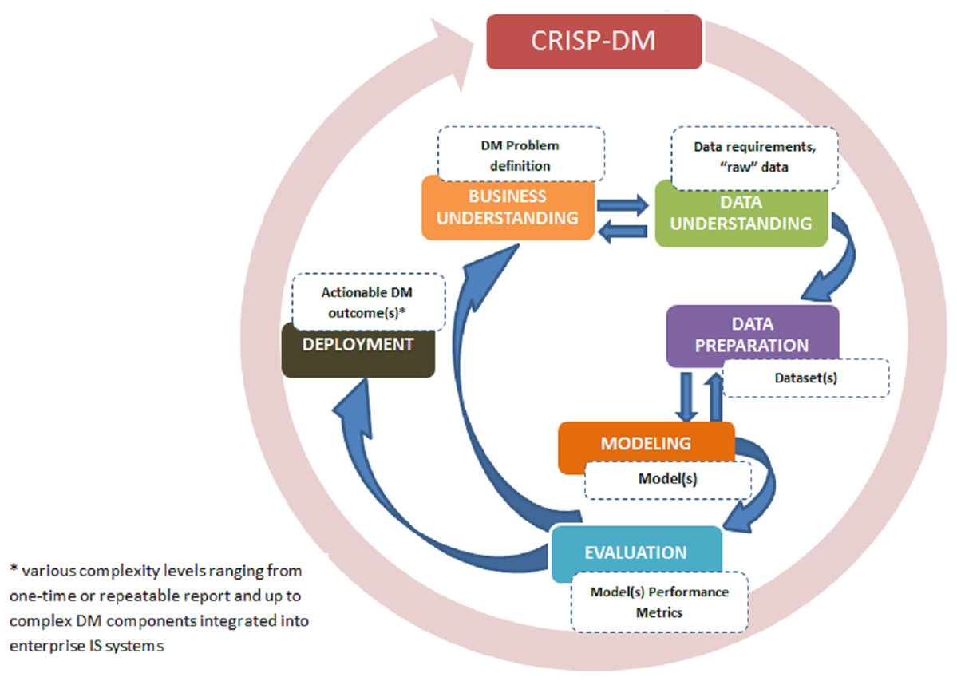
Methodoligy
CRISP-DM
Notes:
1. Business Understanding
The skip and waste management industry lacks predictive tools and effective dashboards. This project aims to develop a dashboard with a predictive model to forecast container demand, enabling better decision-making. The tool is expected to improve operational efficiency and reduce reliance on manual forecasts.
2. Data Understanding
Due to confidentiality concerns, real data was unavailable. A synthetic dataset was created using AI, including these columns:
Numerous column were created such as date and containertype.
3. Data Preparation
The AI-generated dataset was structured based on the required columns, but further cleaning or preparation steps were not performed, as the data was solely for testing.
4. Modeling
A predictive model was integrated into the dashboard to identify container demand. The model’s performance was reviewed continuously after each modification.
5. Evaluation
Constant evaluation ensured each change added value to the dashboard, focusing on the tool’s predictive and operational utility.

Slide 4
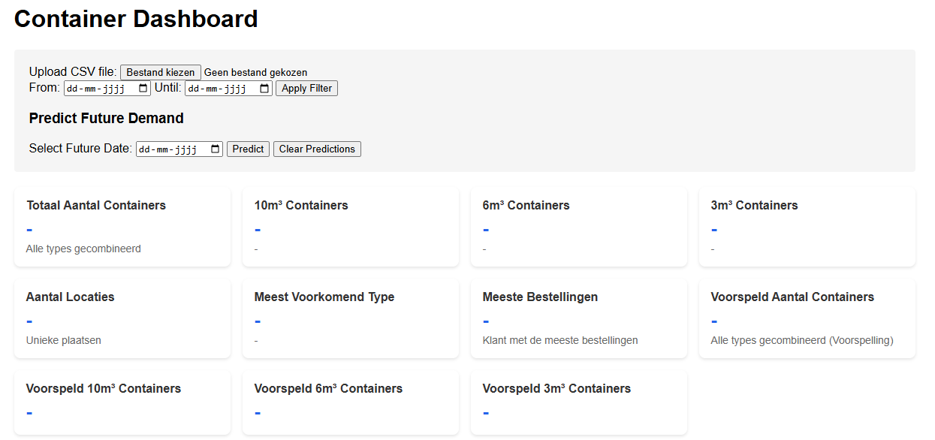
The dashboard

Slide 5
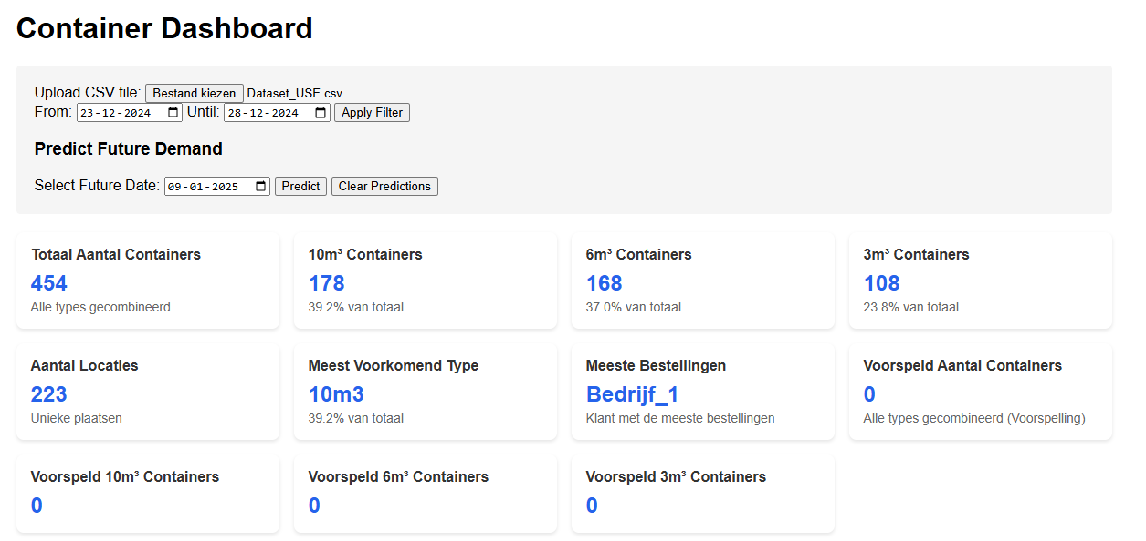
The dashboard – statistics

Slide 6
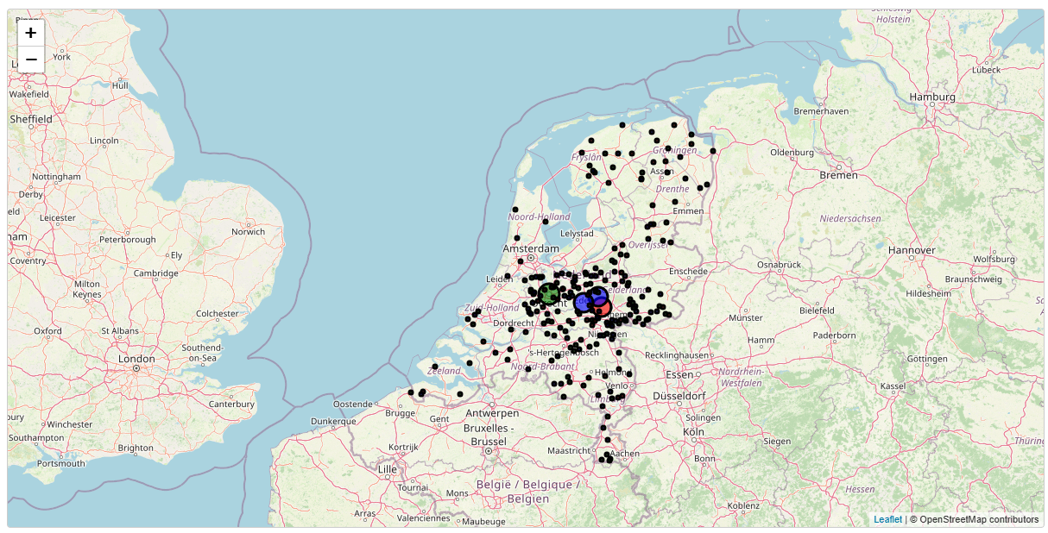
The dashboard – The map
Notes:
On this maps dots are visible. With the bigger the dot the more containers have been ordered in that city.

Slide 7
Self reflection
Not the desired result
Reflection- model of Korthagen
JPR.vanWoudenberg@student.han.nl
Notes:
Unfortunately the project did not go as planned. The Product is not as functional as it was desired. Due to this i have used the reflection model of Korthagen to reflect on the project and focus on what i need to do in order to succeed the next time. In the report there is more depth to this.
For now i want to thank you for listening to my presentation of my indivudual project. If any questions may arrise feel free to email me on the emailadress on the screen

